Slide 1
PYTHON FOR DATA SCIENCE

Slide 2
Agenda
Introduction
Data Structures
Numpy
Pandas
Data Merging
Data manipulation and Data Wrangling
Exploratory Data Analysis
Visualization of Data

Slide 3






Introduction
Python is a general-purpose interpreted, interactive, object-oriented,
and high-level programming language.
Simple
Easy to Learn
Free and Open Source
Extensible
Portable
High-level Language

Slide 4
Data Structure
Python has four basic inbuilt data structures. These almost cover 80% of the our real world data structures. These are as follow:
List
Tuples
Dictionary
Sets

Slide 5
List
A list is a collection which is ordered and changeable. In Python lists are written with square brackets.
List is mutable which means the elements inside a list can be changed.
It has many functions like:
.append(), .extend(), .sort(), .reverse() etc.
Create a list:
lst= [‘a’,1,2.5]
Access items of the list
List name[index number]
Tuples
Tuples are similar to lists but they are immutable i.e. they cannot be changed. You would use the tuples to present data that shouldn't be changed, such as days of week or dates on a calendar.
Tuples are written with round brackets
It doesn’t support functions like .append().
Create a tuple:
t = (1,2,3)
Access items of the list:
Tuple name[index number]

Slide 6
Dictionary
A dictionary is a collection which is unordered, changeable and indexed. In Python dictionaries are written with curly brackets, and they have keys and values.
Create the dictionary:
dictionary ={'a':1, 'b':2, 'c':3, 'd':4, 'e':5}
Accessing items:
Get the value of ‘a’ key
dictionary[‘a']
Sets
Sets are an unordered collection of unique elements. In Python sets are written with curly brackets.
You cannot access items in a set by referring to an index, since sets are unordered the items has no index.
Create a set:
fset = {“a", “b", "c"}
Access Items:
for x in fset: print(x)

Slide 7
Numpy
NumPy is a general-purpose array-processing package. It provides a high-performance multidimensional array object, and tools for working with these arrays.
Besides its obvious scientific uses, Numpy can also be used as an efficient multi-dimensional container of generic data.
To import the Numpy library we use:
Import numpy as np
An array class in Numpy is called as ndarray.
Numpy is also used to make the matrix
We can perform various functions in Numpy like Random number generation, arrange and reshaping indexing and slicing, finding square-root, exponential etc.

Slide 8
Pandas
Pandas is a data science library aimed at quick and simplified data munging and exploratory analysis in Python. Specifically, it provides high-level data structures like the ‘DataFrame’ (similar to the R data.frame) and ‘Series’. Additionally it has specialized methods for manipulating and visualizing numerical variables and time series data.
To install Pandas library we use this command:
!pip install pandas
Ensure that the installation was successful by launching Python and write import pandas as pd

Slide 9
Pandas Features
Can import the various types of files
Data structures with labeled axes that enable (automatic or explicit) data alignment
Facilities to add and remove columns on-the-fly
Powerful management of missing data
SQL-like joins (Merge, Append, Set Operations and other relational maneuvers)
Methods for data I/O from/to various file formats like csv, Excel, HDF5, SQL databases
Reshaping (long-to-wide, wide-to-long) and Pivoting (Excel-like)
Label subsetting, fancy slicing
A powerful “GroupBy” method that implements the split-apply-combine strategy operations

Slide 10
Reading Data using Pandas
Read csv files:
df= pd.read_csv("'C:\\Users\\HP\\Material FV\\Data.csv“)
There is a number of pandas commands to read other data formats:
pd.read_excel('myfile.xlsx',sheet_name='Sheet1', index_col=None)
pd.read_stata('myfile.dta')
pd.read_sas('myfile.sas7bdat')
pd.read_hdf('myfile.h5','df')

Slide 11
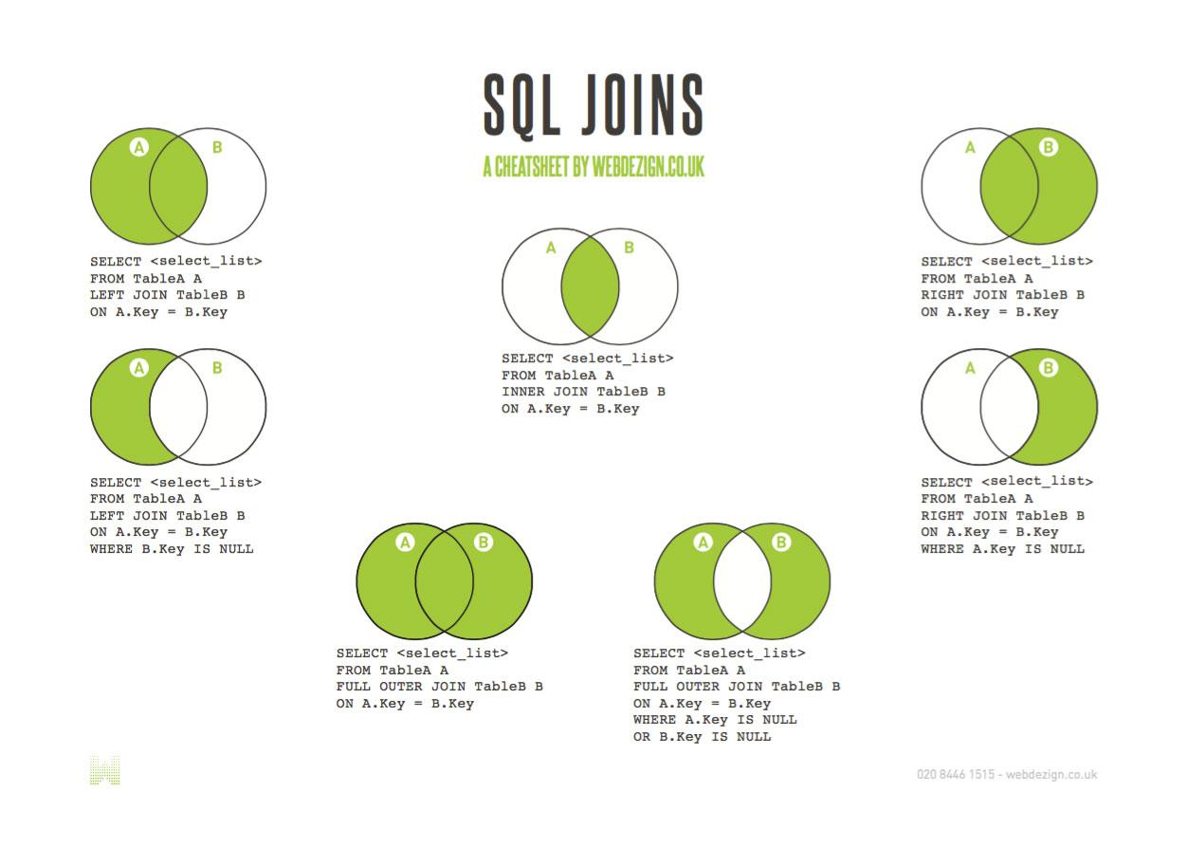
Data Merging
We can join, merge, and concat dataframe using different methods. In Dataframe df.merge(),df.join(), and df.concat() methods help in joining, merging and concating different dataframe.

Slide 12
.merge() function:
merge(df1, df2, how='left', on='key', left_on=None, right_on=None, left_index=False, right_index=False, sort=True, copy=True, suffixes=('_x', '_y'))
.join() function: By default, the join method performs a left join on the join keys.
res = df.join(df1, how='outer')
.concat() function:
pd.concat([df1, df2], axis=1, keys=['df_1', 'df_2'])
.append() function:
res = df1.append(df2)

Slide 13
Data manipulation and Data Wrangling
This contains topics as follow:
Impute missing values
Understand the data
Pivot Table
Removing Duplicates
Binning Numerical Variables to Categorical
Create Dummies for a Categorical Variable
String Method
Group by method
Plotting

Slide 14
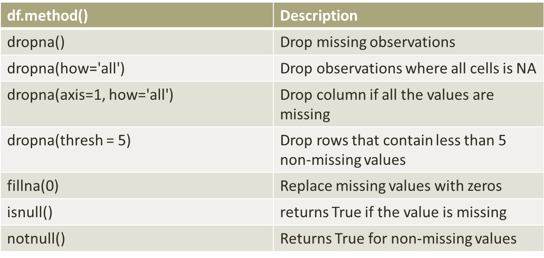
Missing Values
There are a number of methods to deal with missing values in the data frame:

Slide 15
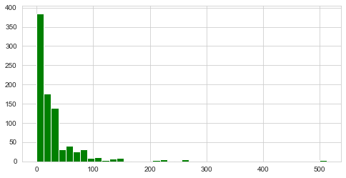
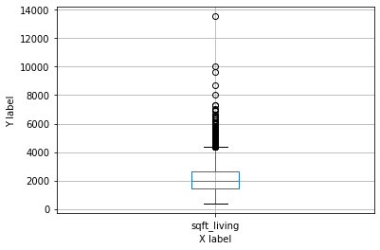
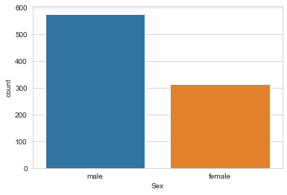
Exploratory Data Analysis
1. Univariate Analysis- We explore variables one by one. Method to perform uni-variate analysis will depend on whether the variable type is categorical or continuous.

Slide 16
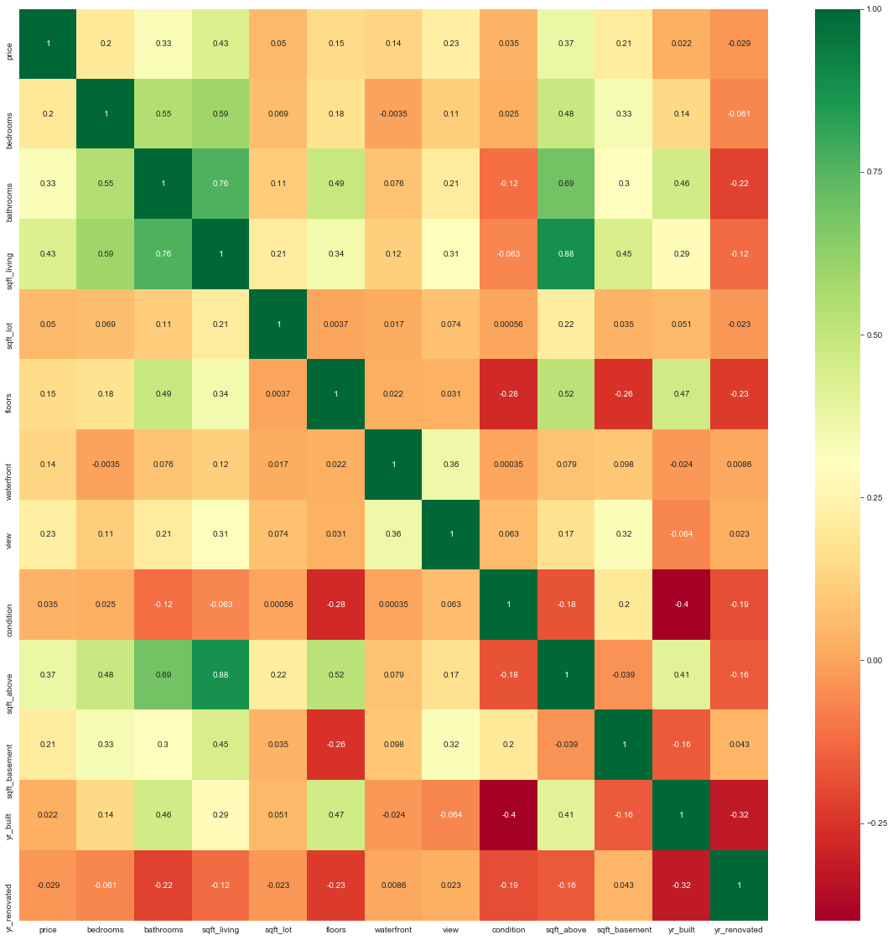
2. Bivariate Analysis: Bi-variate Analysis finds out the relationship between two variables.
For Continuous and Continuous: Correlation, as a statistical term, is the extent to which two numerical variables have a linear relationship
Correlation tells us two variables (X) and (Y) are related
Correlation varies between -1 and +1.

Slide 17
For Categorical & Categorical: We use chi-square test for this purpose. This test is used to derive the statistical significance of relationship between the variables. Also, it tests whether the evidence in the sample is strong enough to generalize that the relationship for a larger population as well.
Interpreting results: If p-value is less than significance level, there is an association between Variable A and Variable B
For Categorical & Continuous: While exploring relation between categorical and continuous variables, we can draw box plots for each level of categorical variables. If levels are small in number, it will not show the statistical significance. To look at the statistical significance we can perform Z-test, T-test or ANOVA
Z-Test/ T-Test:- Either test assess whether mean of two groups are statistically different from each other or not.
ANOVA:- It assesses whether the average of more than two groups is statistically different.

Slide 18
Visualization of Data
Tables and Graphs : Why use them?
Communicate complex information concisely and powerfully
Create a “picture” for reasoning about and analyzing quantitative and conceptual information
Makes cognitive processing easier
Provides “content/information rich” view at a glance
Directs attention toward the content rather than methodology
Describe, explore, summarize a set of numbers
Convey a message about the significance of the data

Slide 19
Python libraries for Visualization
matplotlib:
python 2D plotting library which produces publication quality figures in a variety of hardcopy formats
a set of functionalities similar to those of MATLAB
line plots, scatter plots, barcharts, histograms, pie charts etc.
relatively low-level; some effort needed to create advanced visualization
Seaborn:
based on matplotlib
provides high level interface for drawing attractive statistical graphics

Slide 20
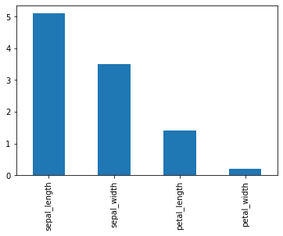
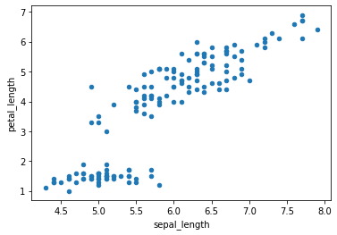
Bar Chart- Bar charts organize
data into rectangular bars that make
it a breeze to compare related data sets.
Scatterplot- Scatterplots are the right
data visualizations to use when there
are many different data points, and
when looking for outliers or for
understanding the distribution
of your data.

Slide 21
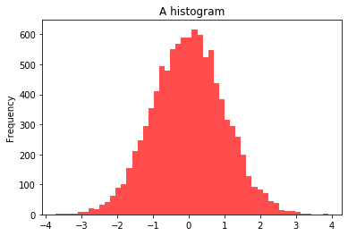
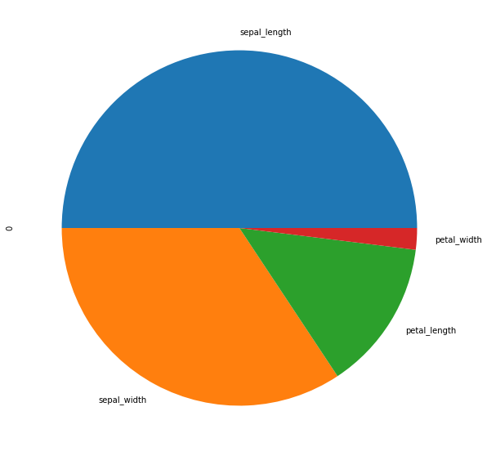
Histogram- Histograms give an estimate
as to where values are concentrated,
what the extremes are and whether
there are any gaps or unusual values
throughout your data set.
Pie Chart- Pie charts are an interesting
graph visualization. At a high-level,
they're easy to read and understand
because the parts-of-a-whole relationship
is made very obvious.

